Slide 1

Team Name : Vahini
Team Leader Name : Divyanshu Patel
Problem Statement : Build an AI-powered solution that improves access to information, resources, or opportunities for communities and public systems.

Slide 2







Brief about the Idea:
The Problem
78 Million
eligible citizens miss out on ₹1.2 Trillion in annual government benefits
Low Connectivity
400M users on 2G networks; text-heavy apps unusable
Language Barriers
Digital Illiteracy
70% rural India speaks local languages; info exists only in English/Hindi
450M Indians cannot read or navigate digital interfaces
Our Solution: SchemaSetu
A multilingual, voice-first AI platform that helps citizens discover, understand, and apply for government welfare schemes in minutes accessible on basic phones with minimal data, available 24/7 in their own language.
100% Voice Interface
Proactive AI Agent
22+ Languages
Works on 2G
"The First AI That Calls the Farmer"
Zero reading required
Calls users when eligible
Including 40+ dialects
500KB per query

Slide 3
How Is It Different?
Feature | Existing Solutions | SchemaSetu
Voice Interface | ❌ Text-only | ✅ Primary mode
Language Support | 3-4 languages | 22 languages + 40 dialects
Connectivity | Requires 4G/WiFi | Works on 2G (500KB)
Intelligence | Keyword search | ML matching (92% accuracy)
User Experience | Reactive (user asks) | Proactive (AI calls user)
Memory | None | Household context persists
Offline Access | ❌ Not available | ✅ IVR + Missed Call

Slide 4


How Will It Solve the Problem?
Literacy Barrier
100% voice interface in 22+ languages and 40+ dialects—no reading required
Connectivity Barrier
Hybrid architecture: WhatsApp when online, IVR calls when offline; works on 2G
Awareness Gap
AI analyzes household profile against 1000+ schemes, proactively alerts about eligible benefits
Process Complexity
Voice-guided micro-tasks with document photo capture and AI-powered form filling

Slide 5


Our Unique Selling Propositions
1
Voice-First for 450M Digital Illiterates
2
Proactive AI That Calls Users
9x higher adoption than text apps; reaches the unreached
First solution that reaches out when schemes open—not reactive
3
Works on 2G Networks
4
ML-Based Eligibility Matching
500KB per query; 95% less data than competitors; 400M rural users
92% accuracy vs 40% keyword search; 5x higher conversion

Slide 6


Features Offered
Voice Interaction
AI Intelligence
Voice query input
Real-time transcription
22 language support
Voice biometric auth
ML eligibility matching
Household memory graph
92% accuracy scoring
Proactive voice alerts
Guidance & Support
Accessibility
Simplified explanations
Document checklist
Step-by-step application
Status tracking
Works on 2G/feature phones
IVR + WhatsApp + SMS
Offline missed-call trigger
24/7 availability

Slide 7
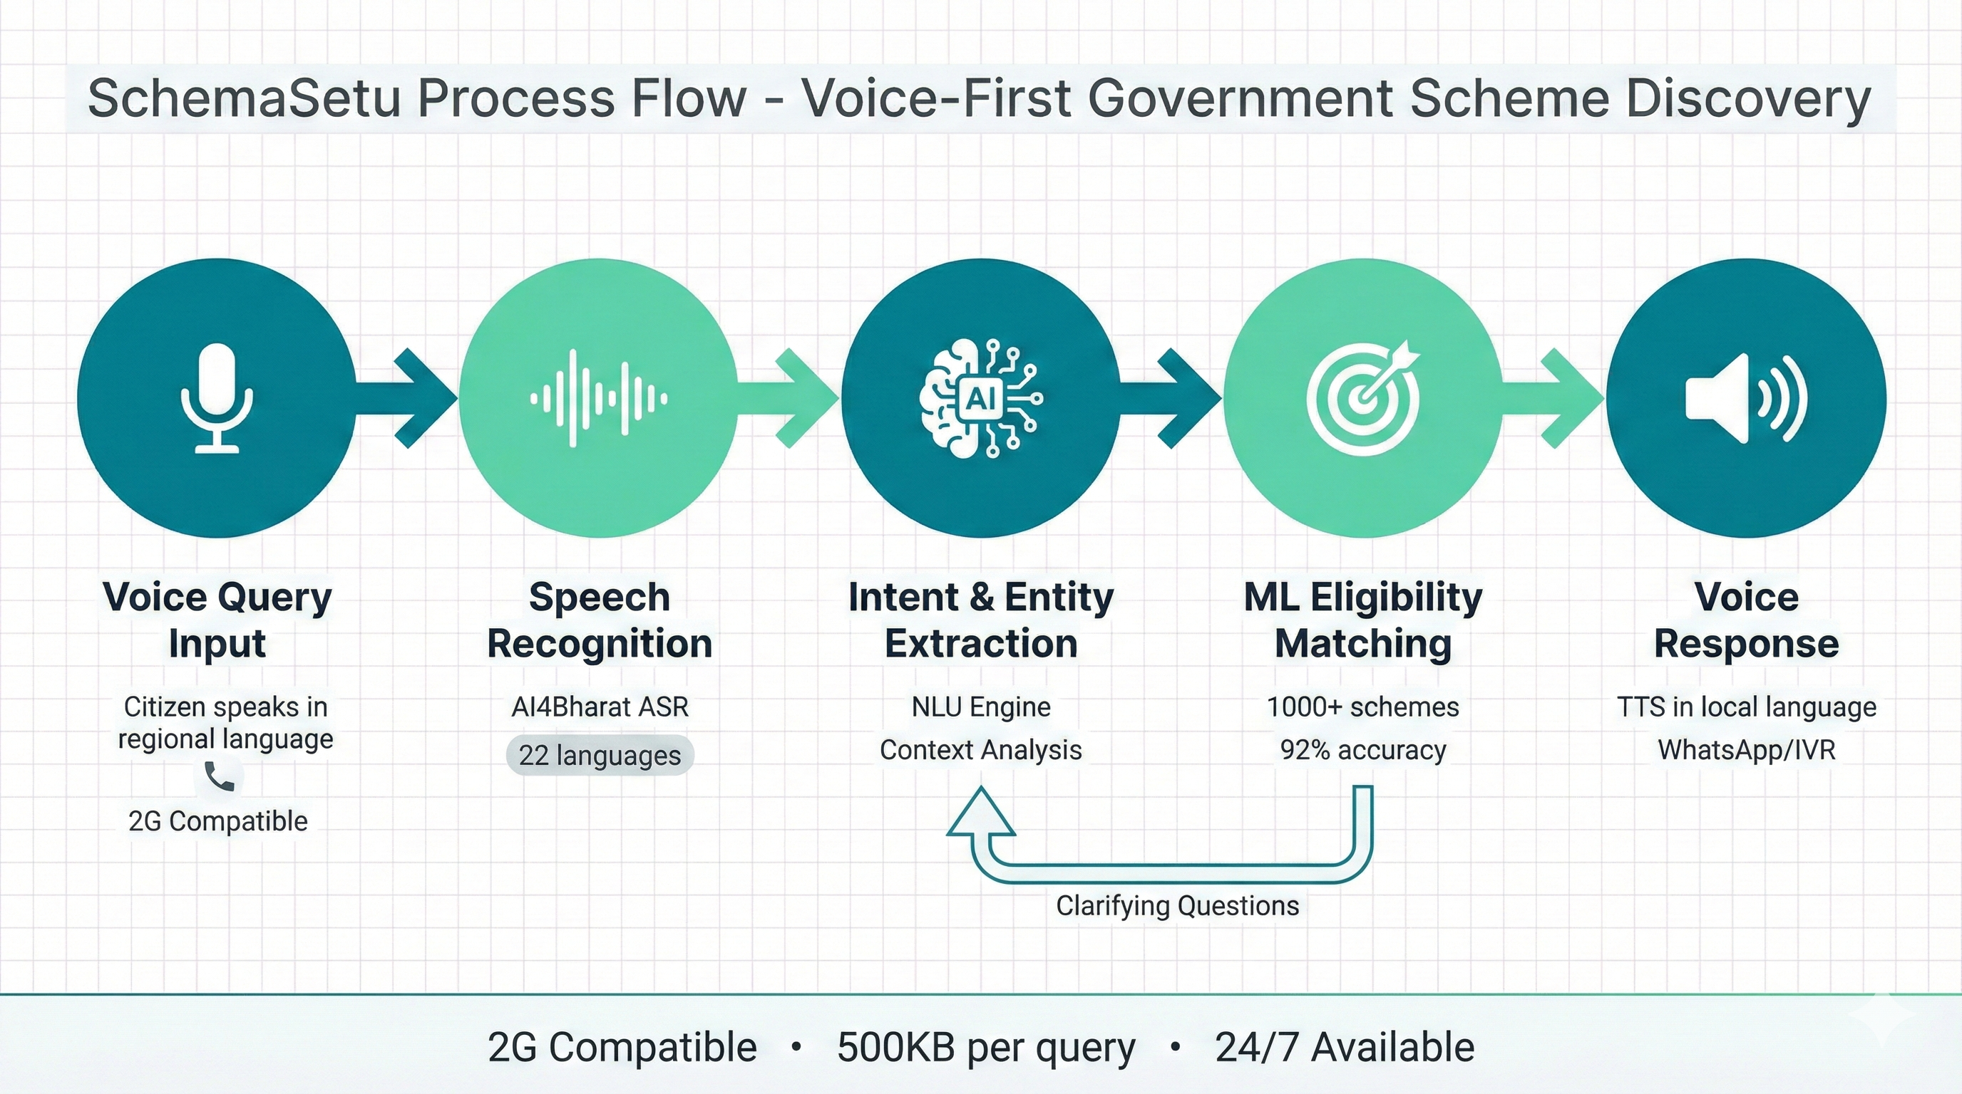
Process Flow: User Journey

Slide 8
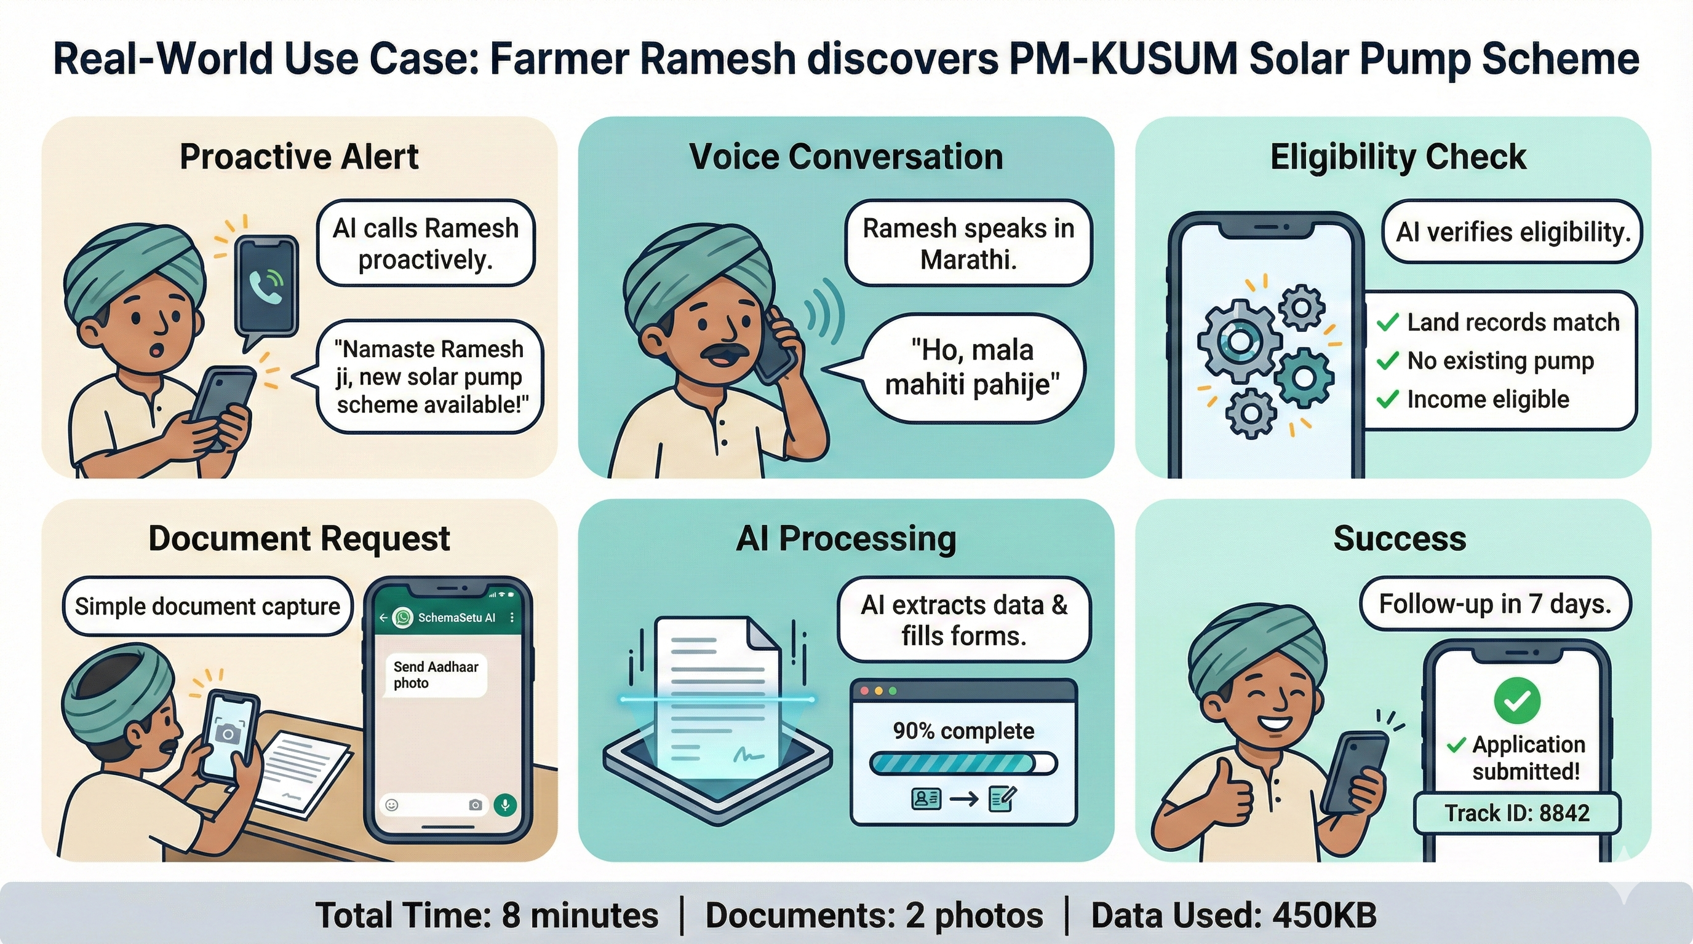
Use Case: Farmer Scenario

Slide 9
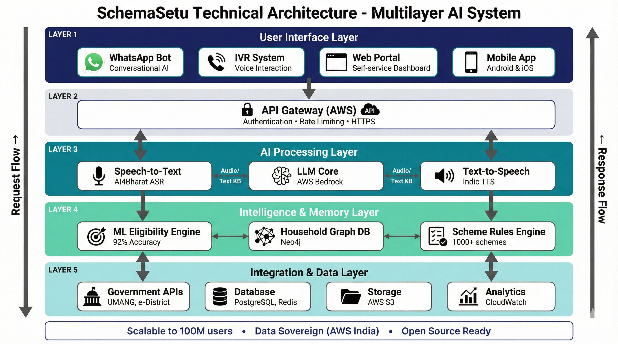
System Architecture

Slide 10
Technologies to be Used
Voice & NLP
ML & Intelligence
AI4Bharat ASR/TTS
Whisper Speech Recognition
Bhashini Translation
AWS Bedrock (LLM)
Scikit-learn (92% accuracy)
Neo4j (Memory Graph)
XGBoost Classifier
Hugging Face Transformers
Backend & Infrastructure
Integration & Access
Node.js + FastAPI
PostgreSQL + Redis
AWS Lambda + ECS
WhatsApp Business API
IVR (Twilio/Exotel)
Government APIs (UMANG)
SMS Gateway (AWS SNS)
CSC Network Integration

Slide 11
Estimated Implementation Cost
MVP Development
Pilot Deployment
State-wide Scale
3 months
6 months
12 months
₹12 Lakhs
₹30 Lakhs
₹1.5 Crores
1,000 users pilot
50,000 users
1M users
Monthly Operational Cost (1M users): ₹40 Lakhs | Per-User: ₹4/month

Slide 12
Expected Impact
1M Citizens
400M+ Users
15 Minutes
Access ₹2,000 Cr benefits in Year 1
Rural/non-digital users reached
Down from 3-4 hours per application
Enable data-driven policy making for government
Build open infrastructure for 10+ ministries to adopt
Create training dataset for Indian AI ecosystem
WCAG 2.1 AAA accessible - first of its kind
Let's Bridge the Information Gap
Team Vahini | SchemaSetu

Slide 13
